Slide 1
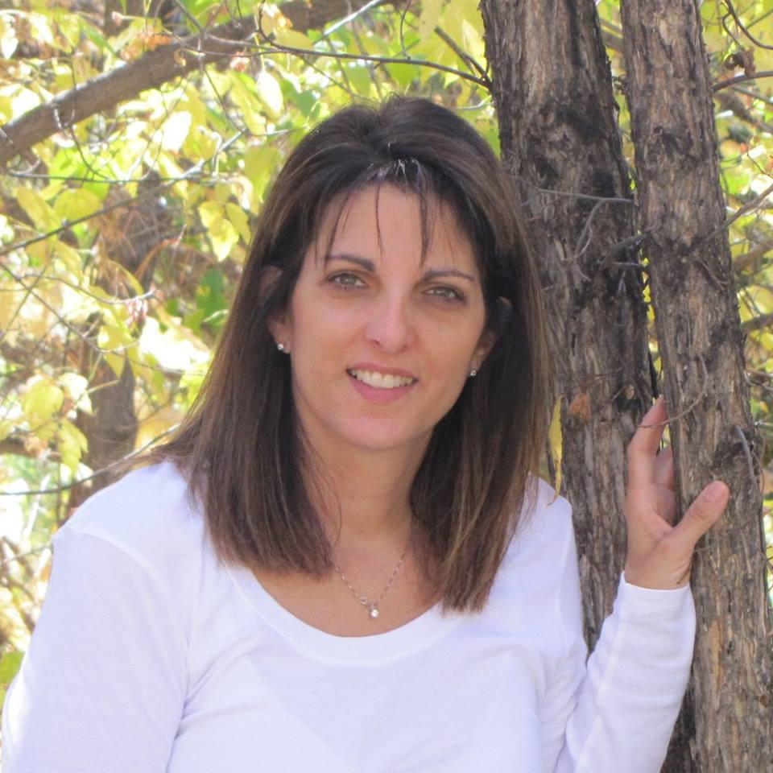
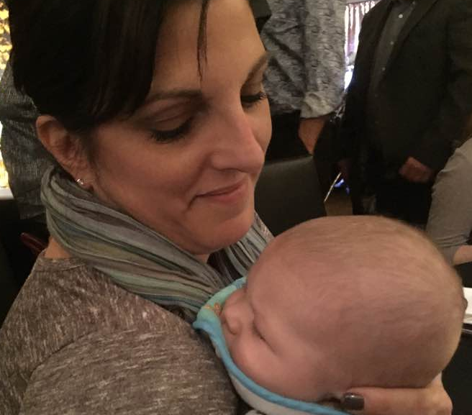
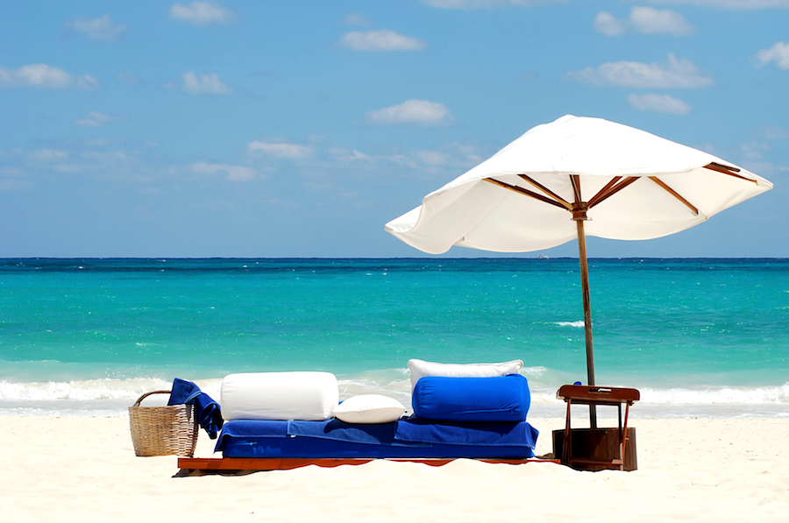
Donna’s Dream Board…
Own a Starbucks Coffee Bar
See Clint (my husband) take retirement.
Watch Carrie (my daughter) get married someday.
Become a Grandmother!! (Baby compliments of Jordan & Rachel Miller
Going on a warm vacation in the middle of winter!

Slide 2
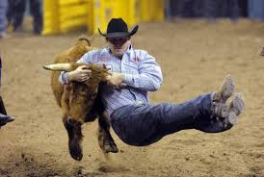
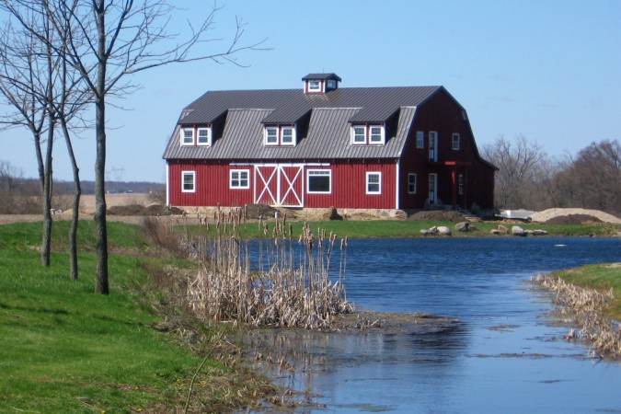
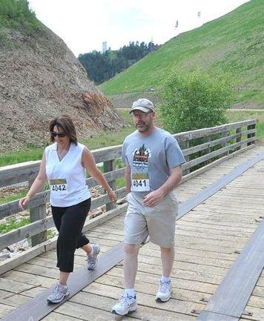
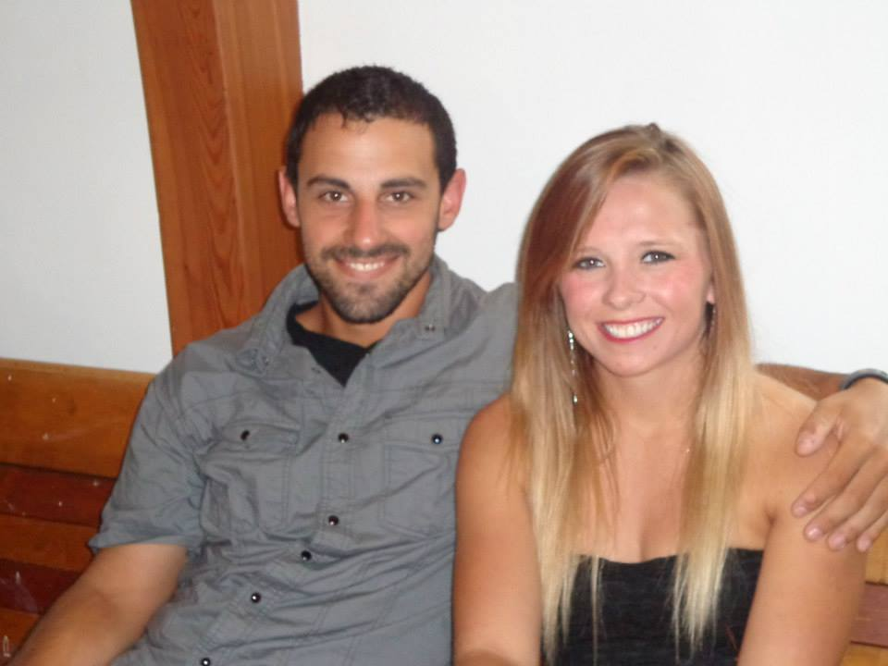
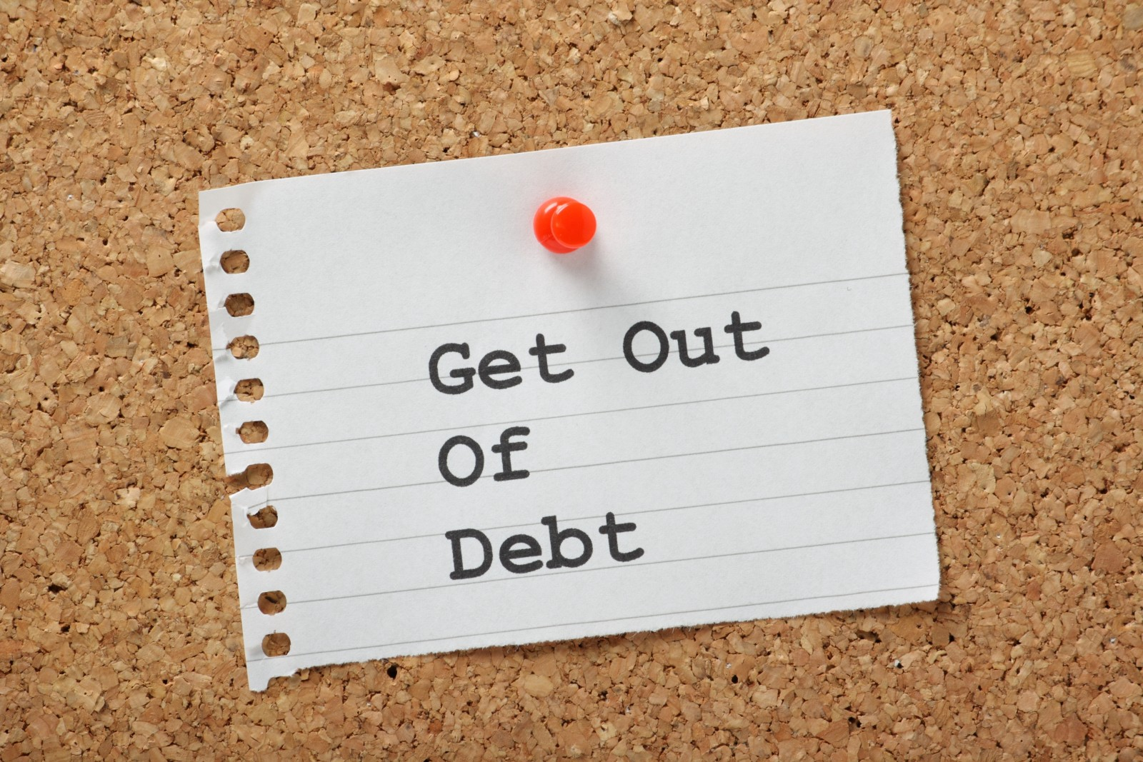
Watch the National Finals Rodeo in Las Vegas NV
Live in an old barn made into a home and raise lots of dogs
Get fit and train to “run” a 5K
See these two kids become husband and wife this summer.
Payoff ALL school loans and debts

